Slide 1
Welcome to Cisco!

Slide 2

Welcome to Cisco
At Cisco we are committed to transact with our suppliers in a global accessible platform for onboarding, including purchasing through invoicing.
The following pack provides information on the post on-boarding and enablement of third-party suppliers of goods and services for the Cisco business globally. This includes supporting information on SAP Business Network, and expectations when transacting with Cisco and other related resources to support Suppliers.
This guide will help you with the below activities:
  Expected Flow (Page 3)
  Account Creation (Page 4-9)
  Update Remittance (Page 10-14)
  Accessing PO (Page 15-17)
  Submitting invoice against the PO (Page 18-27)

Slide 3
Expected Flow – Next Steps
Congratulations!
Cisco
Supplier
You are now a Cisco supplier
Cisco Business POC will create a Purchase Requisition
Login to SAP Business Network
Internal Reviews and Approvals
Update Remittance
Cisco Issues Purchase Order to the PO transmittal email ID
Access PO
Invoice PO
Note – The timeline for PR/PO will depend based on Cisco’s business requirements

Slide 4
Account Creation

Slide 5
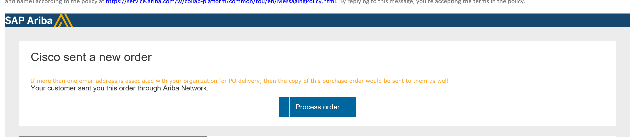
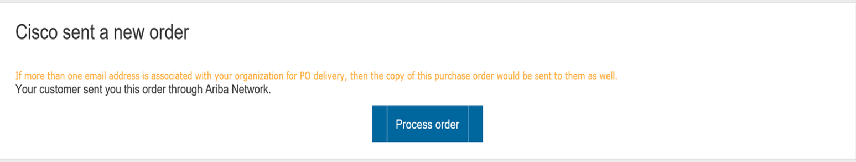
Initial PO copy email sent to supplier’s registered email ID from SAP Business Network - ordersender-prod@ansmtp.ariba.com
Account Creation

Slide 6
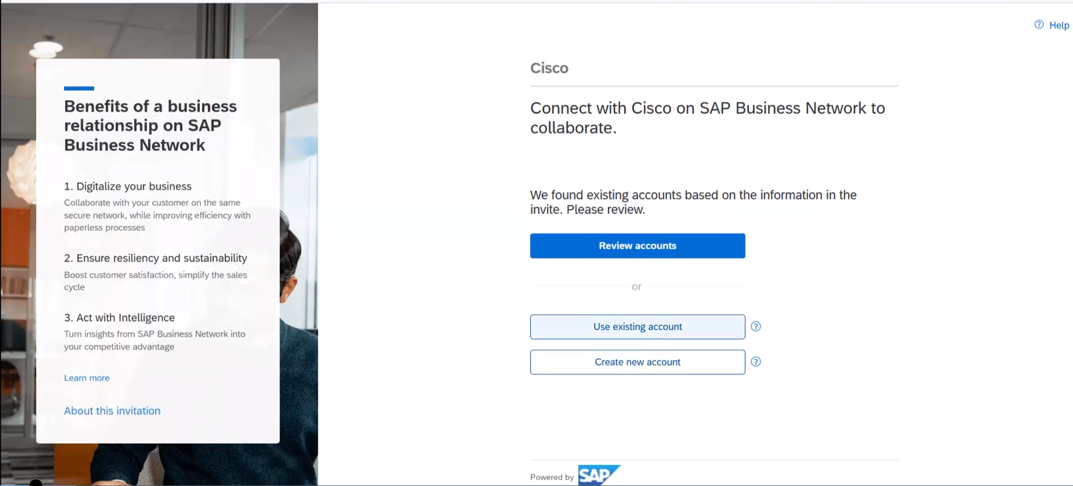
Account Creation
Select the appropriate option from the below:
Use Existing Account – In case if you already have an existing account or want to use the same account which was used during onboarding
Create New Account – In case you do not have an account or want a new account

Slide 7
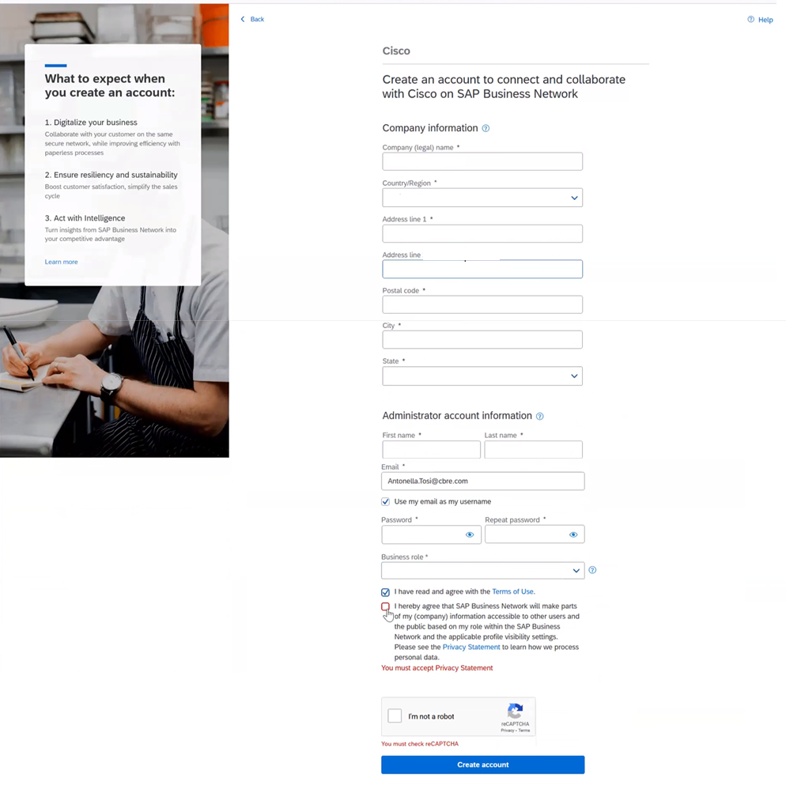
Registering as a new user
Follow these 4 simple steps:
① Enter Company Information fields marked required with an asterisk (*) including:
  Company Name
  Country
  Address
② Enter User Account information marked required with an asterisk (*) including:
  Name
  Email Address
  Username (if not the same as email address)
  Password
③ Accept the Terms of Use by checking the box.
④ Click Create Account to proceed to your home screen

Slide 8
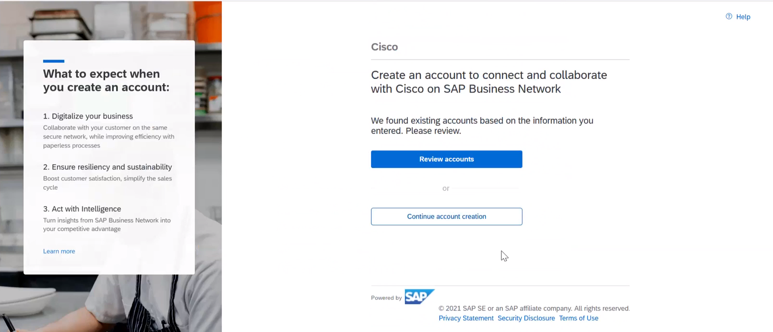
Continue with the account creation

Slide 9
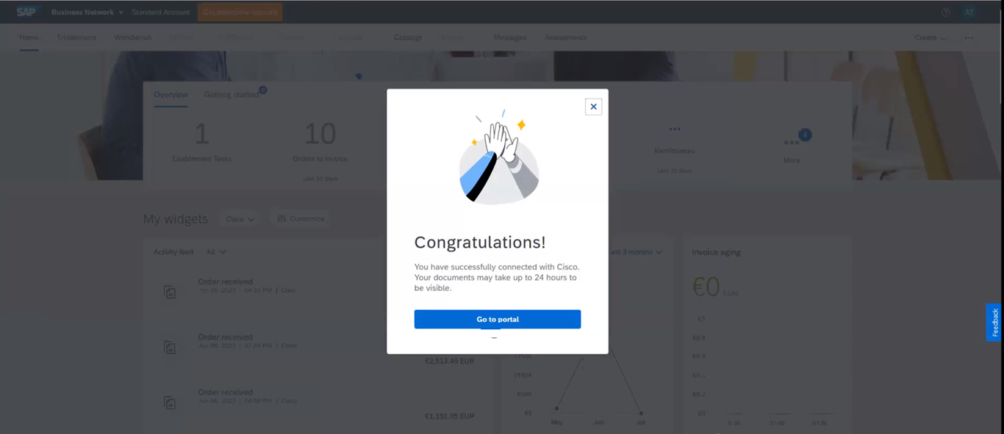
Successful account creation
You will be prompted with the successful account creation. Click here to log into the portal.

Slide 10
Update Remittance

Slide 11
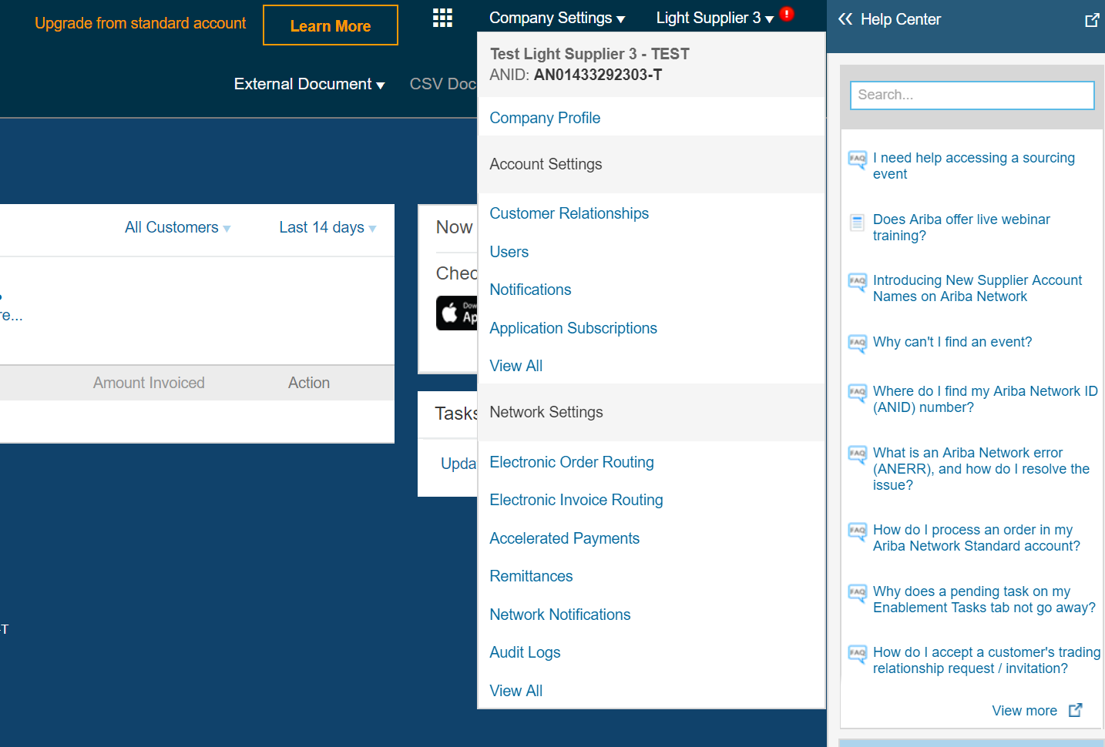
Click “Company Settings” and select “Remittances”

Slide 12
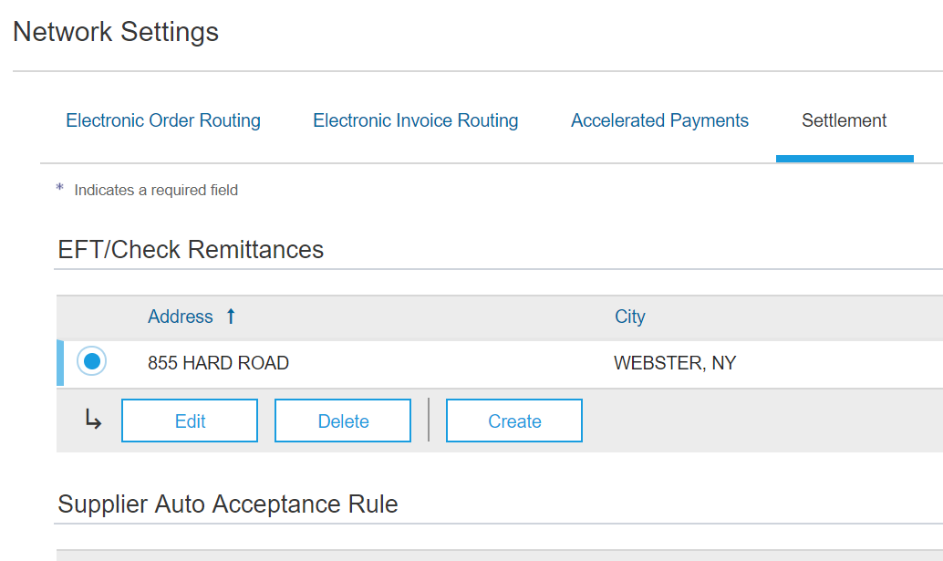
Check the box next to the address you would like to update and click “Edit”
In some cases, this section is blank and needs to be filled in.
Check remittances

Slide 13
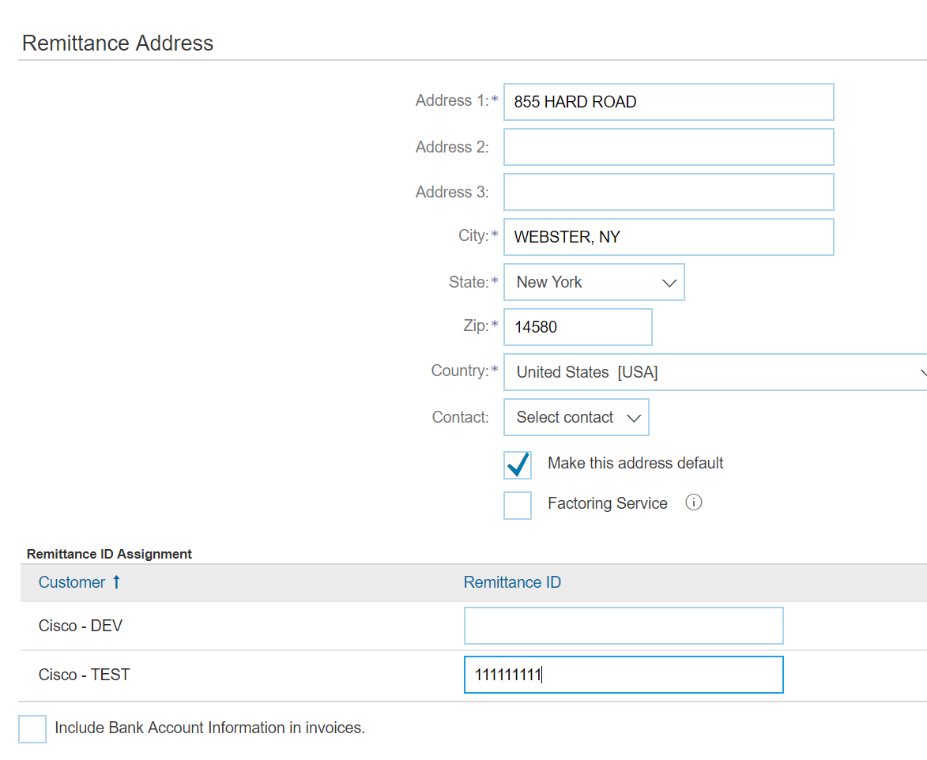
Remittance address
Ensure the address is valid and place the remit ID in the box next to “Cisco” under your list of customers.
Remit to ID is provided in the email.

Slide 14
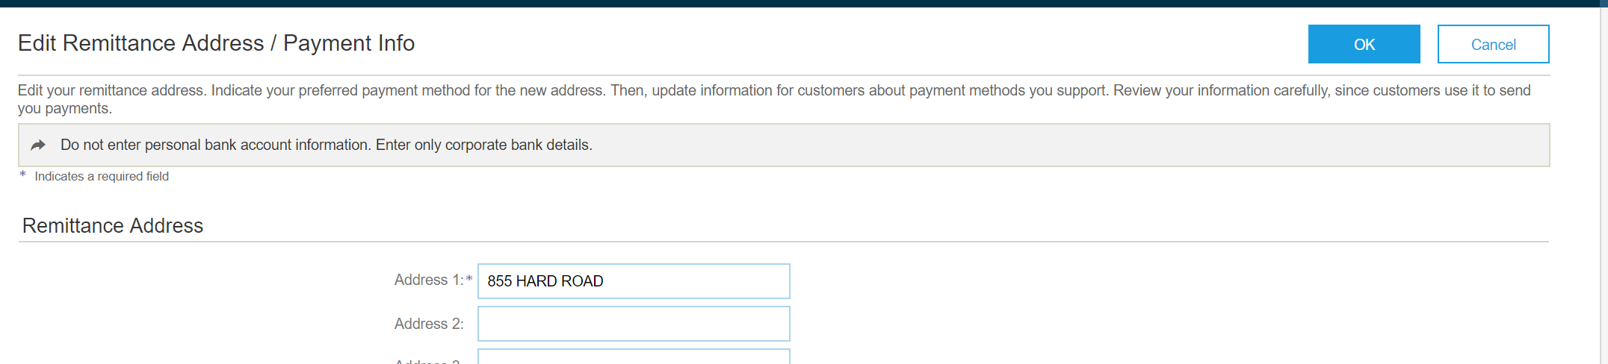
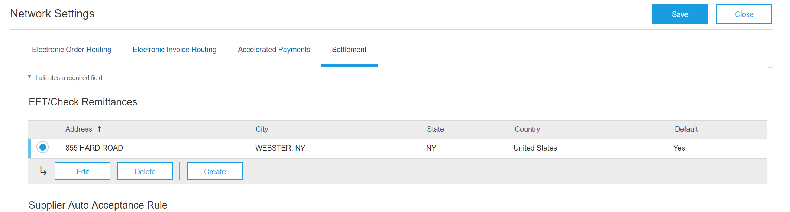
Next steps
Click “Ok”
Click “Save”

Slide 15
Access PO

Slide 16
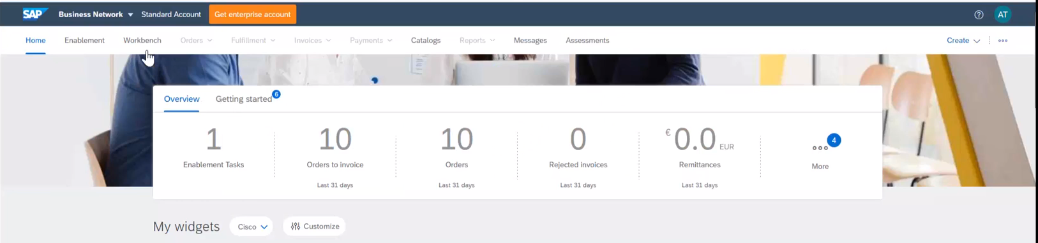
Account View
Your account homepage will give you an overview snapshot of orders placed with your organization. To view the detailed break down of your orders, click on Workbench menu

Slide 17
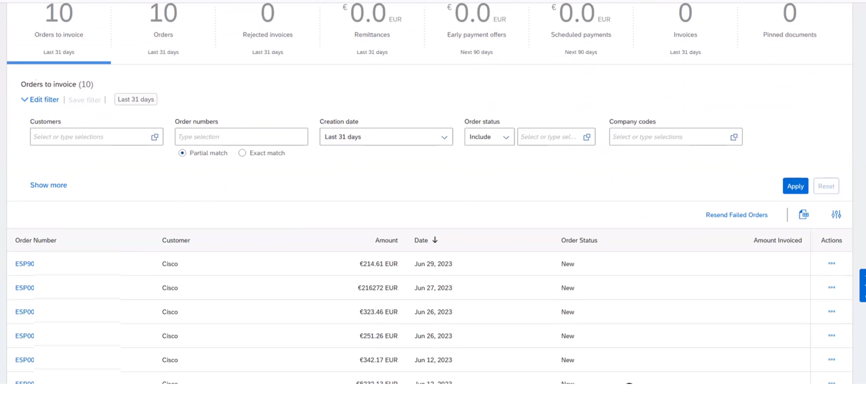
Account Detailed View
All your purchase orders will be listed below from Cisco as a customer.
Choose dropdown to Last 365 days under “Creation Date” (highlighted) and Apply.

Slide 18
Submit Invoice against a PO

Slide 19
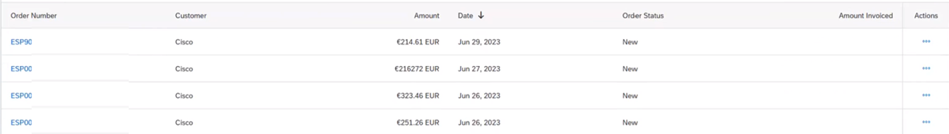
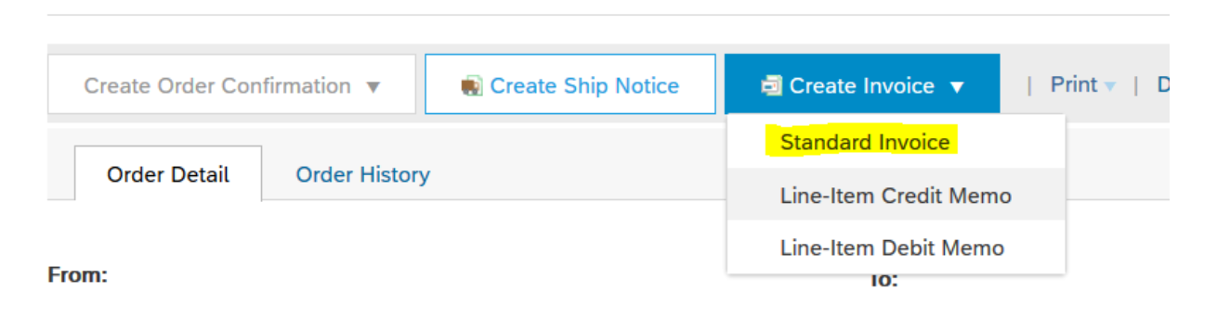
Account Detailed View
Log in to Ariba with your username and password.
Check that the PO number in Ariba matches the number in the subject line of the email.
Select the PO and Click “Create Invoice” and select “Standard Invoice”.

Slide 20
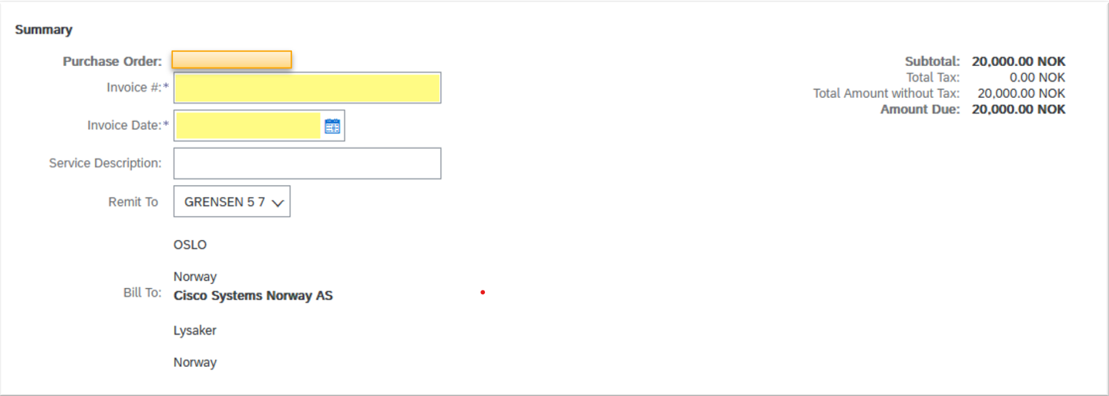
Account Detailed View
Complete all fields marked with (*).
Invoice #: Your invoice number.
Invoice Date: Date of the invoice (same date mentioned in invoice copy).

Slide 21
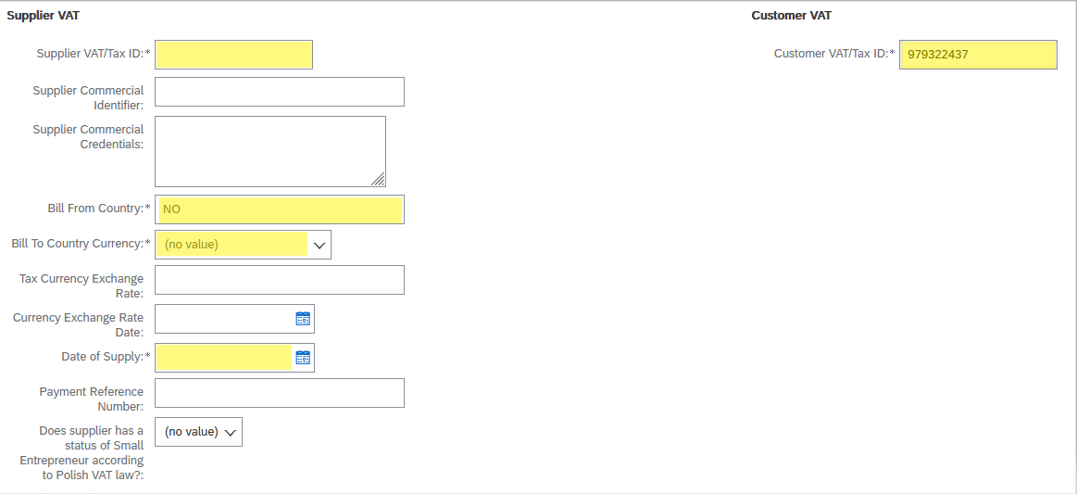
Account Detailed View
Supplier VAT/Tax ID: This is your organization’s organization number.
Customer VAT/Tax ID: This is Cisco’s organization number – 979322437.
Date of Supply: Date must be after the date you received the PO email, and before invoice date.
Note – This is only for Non-US countries.

Slide 22
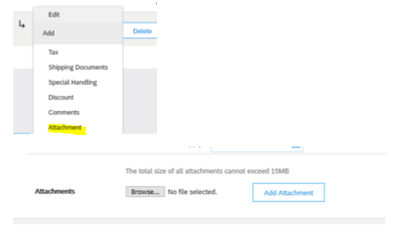
Account Detailed View
Select the line for the product or service. Click “Line Items Actions” and select “Attachment”
Click “Browse…”, select your invoice (pdf) and click “Add Attachment”
Remember that PO number have to be mentioned on PDF invoice.
Cisco requires PDF copy of the invoice to be attached in SAP Business Network.

Slide 23
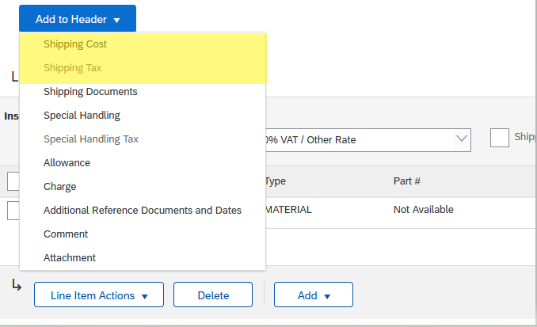
Account Detailed View
If applicable add Shipping Cost. Click “Add to Header”, and select “Shipping Cost”, Attachments (PDF only).
If there is Shipping Cost Tax, repeat process, and select “Shipping Tax”.

Slide 24
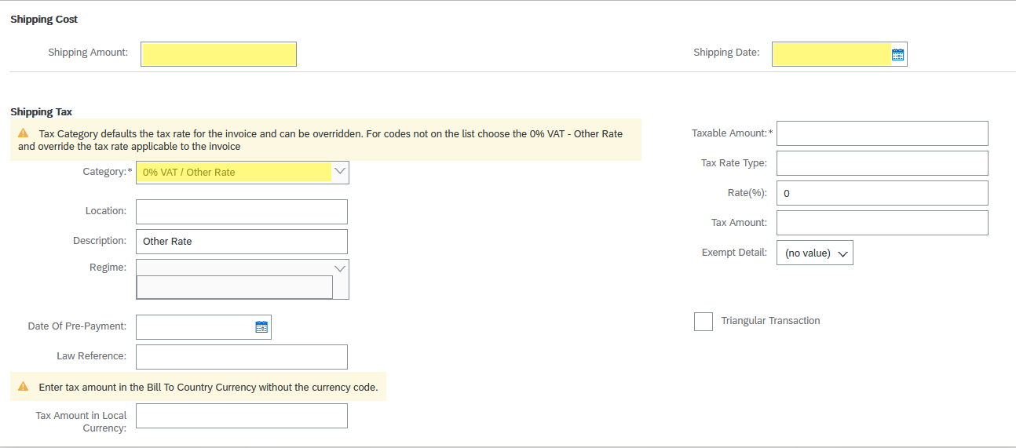
Account Detailed View
Scroll up, and add “Shipping Cost”, shipping date and tax.

Slide 25
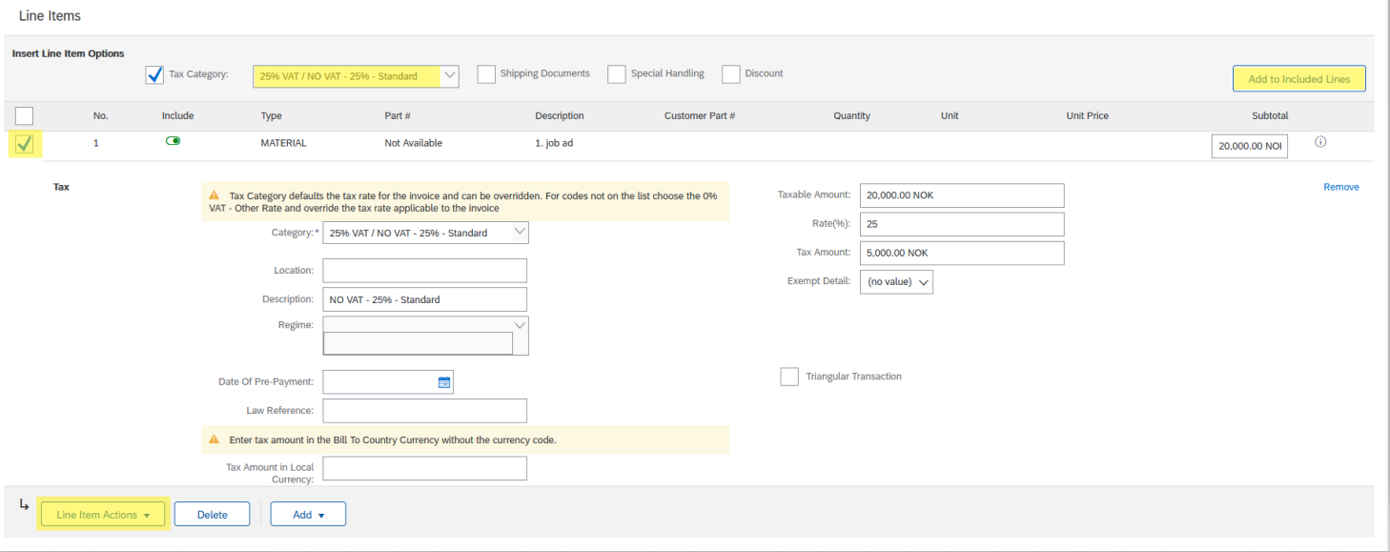
Line items – select the correct Tax Category and click Add to Include Lines.
Account Detailed View

Slide 26
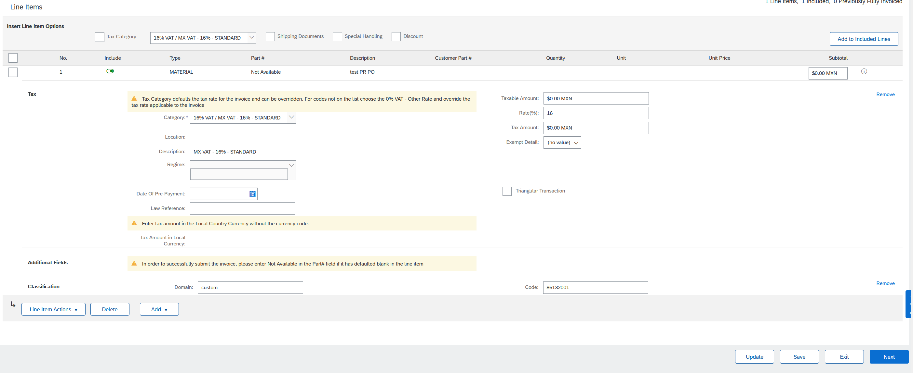
Account Detailed View
When everything looks ok, click “Next”

Slide 27
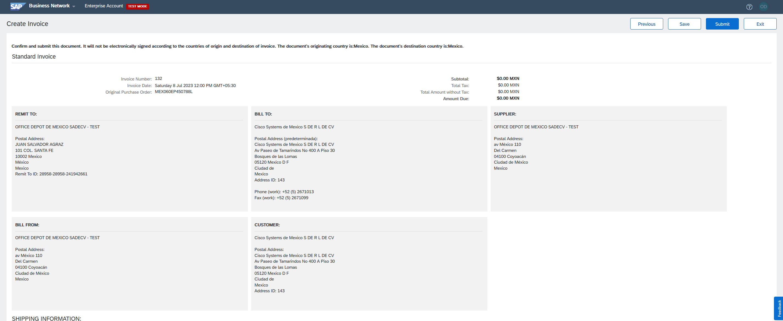
Account Detailed View
If all of the information is correct, click “submit”.
The invoice is now uploaded and sent to Cisco!

Slide 28
Thank You

